Slide 1
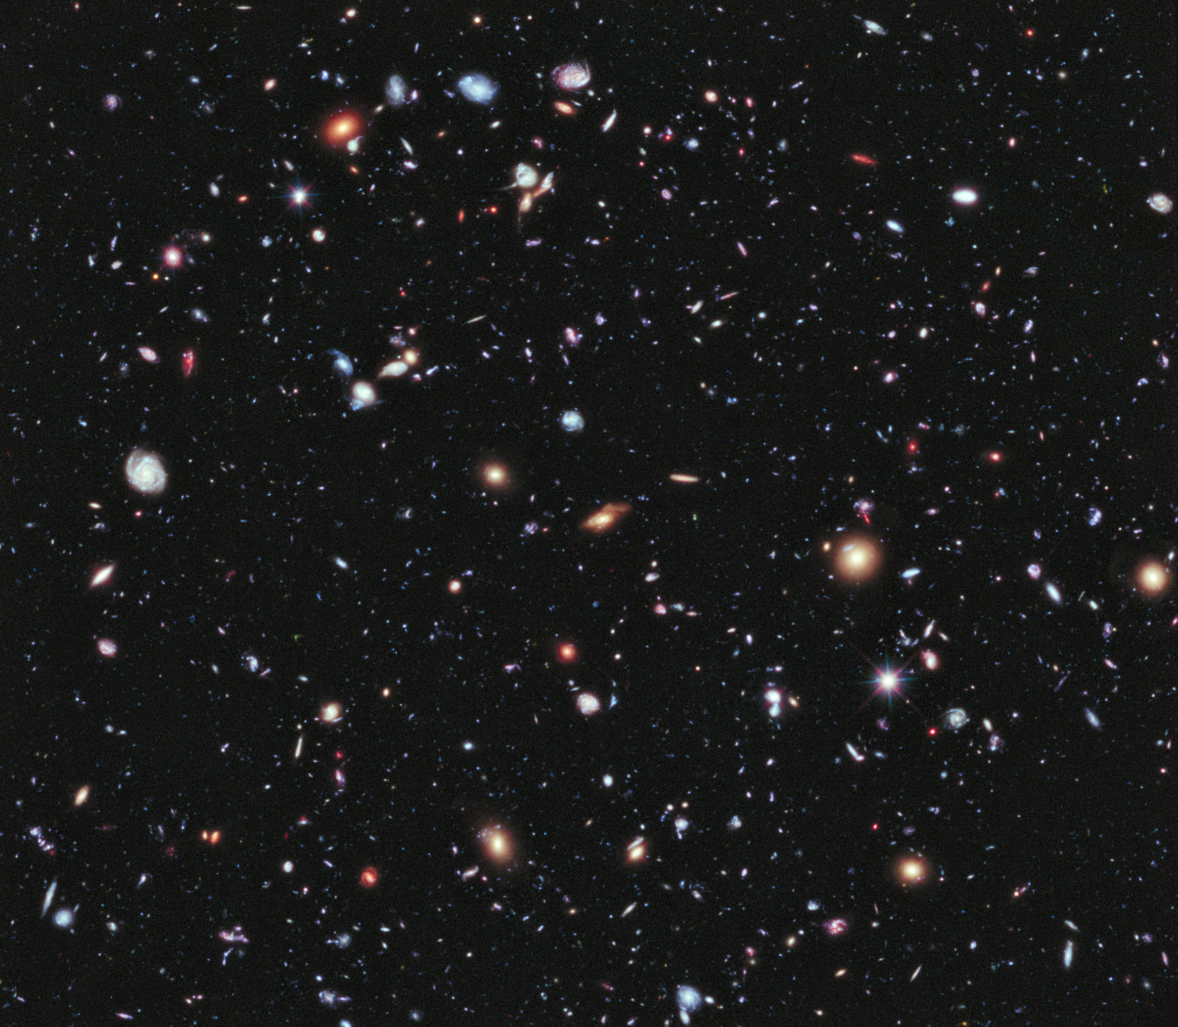
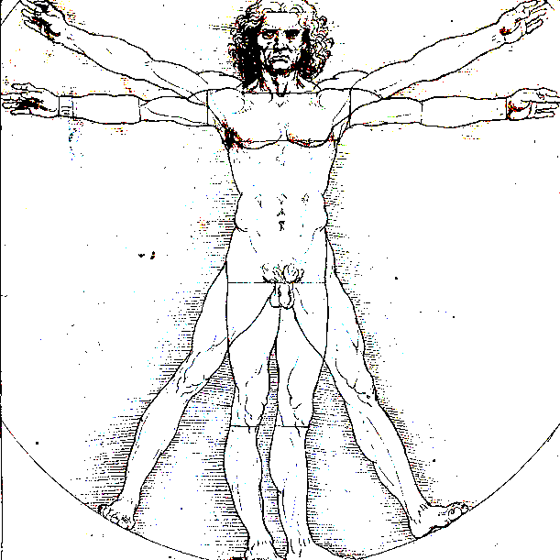
The universe and the mankind
Conference at the SAF, 10/14/2020, by Jacques Fric, PHD history and philosophy of sciences

Slide 2
Prologue

Slide 3
The universe and the mankind
Mankind, as part of the universe, cannot get an objective view of his relationship with the universe because:
You cannot be objective when you are the object itself.
In addition, our view of the universe is from inside. This is not a good place for getting the overall view of the universe.
For instance, the shape of our galaxy is less known than those of other galaxies.

Slide 4
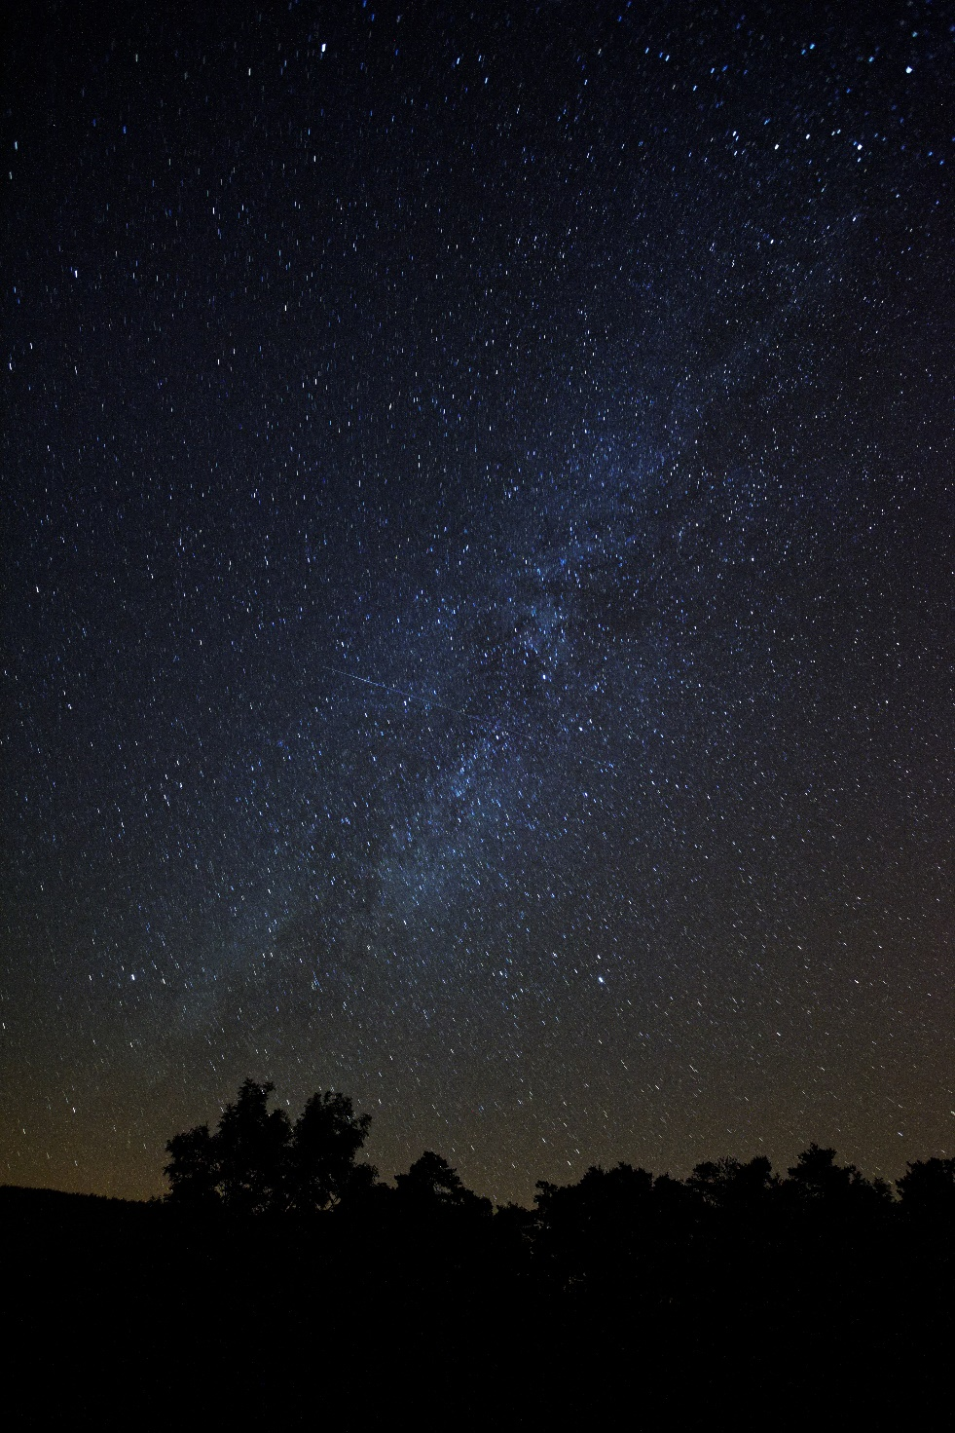
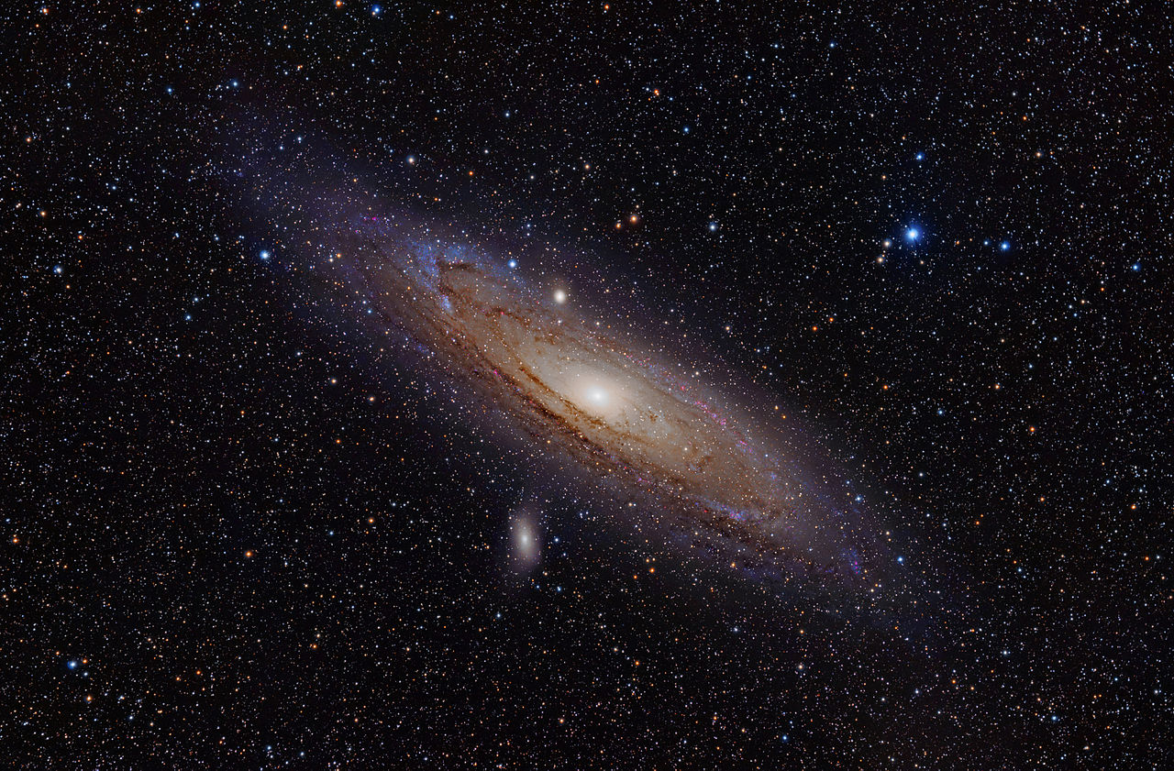
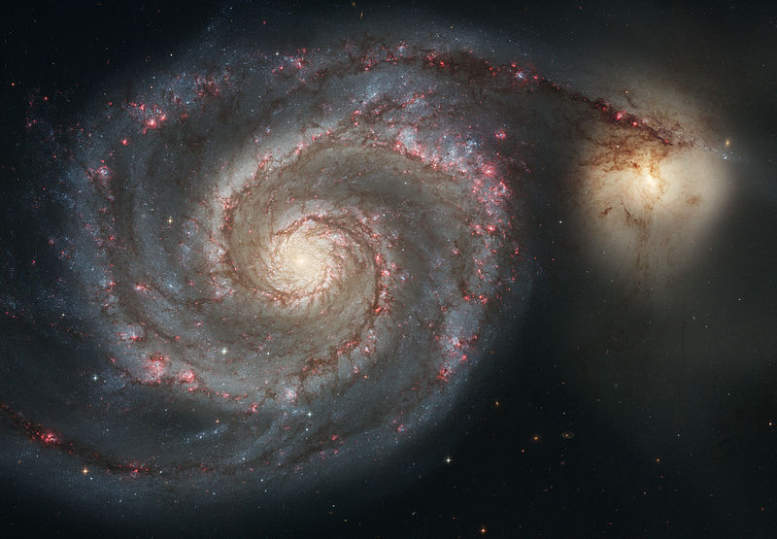
Other galaxies
Up : Andromeda
Down: Whirlpool
Our galaxy seen from Earth

Slide 5
The universe and the mankind
When we are aware of these limitations, we must endeavor to seek the structures which are compatible with them and to consider them as essential.
An essential point, which has been debated throughout, is to question what can be considered "physical reality".

Slide 6
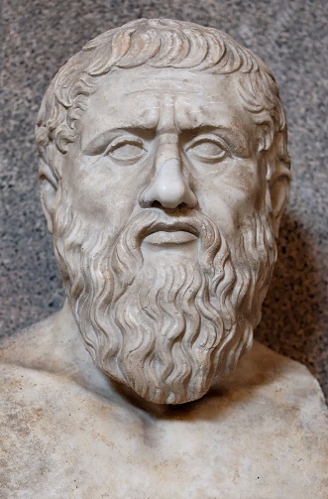

Physical reality? The cavern allegory
Plato in his book "The Republic" wondered how prisoners chained in a cavern, reduced to seeing only shadows of external (unknown) objects could induce that they are only shadows of something they do not perceive.
If the shadows represent real objects, then how can one recover reality from the representation of reality?
Also, if a prisoner claims that the shadows themselves are reality, can one prove that he is wrong?
PLATO 428-348 b.c

Slide 7
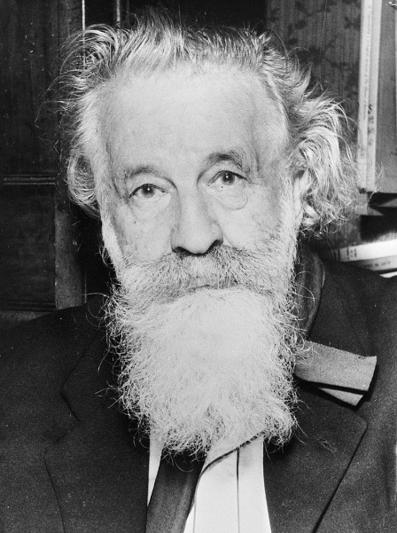
The universe and the mankind
Bachelard, in his book, “Le Nouvel Esprit Scientifique”, points out that:
Our relationship with the universe can just be considered either as a kind of absolute rationalism where the laws of the world are the laws of our mind or, on the opposite, as a universal realism where the laws of our mind are in fact these of the world.

Slide 8
The beginnings of cosmology:
Cosmogony

Slide 9
The origin of universe and its evolution to mankind
Mankind has always wondered about his origins and the origin of the world.
The origin of the universe, as well as ours, is now day (and maybe forever) an open issue but, for the description, from “the cosmogony”, which is usually a religious story, we evolved into a scientific representation, “the cosmology”, which really became efficient at the beginning of the 20th century with the theory of general relativity.

Slide 10
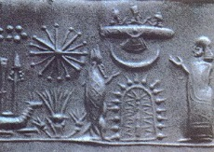

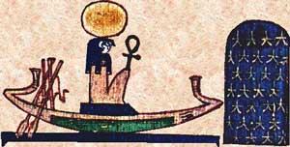
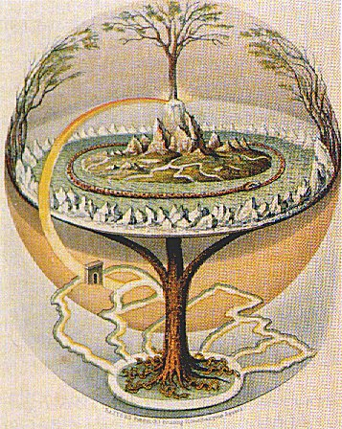
Ancient cosmogony
Egypt: God Ré on his boat
Sumerian seal depicting the Anunnaki
Bereshit pereq aleph, Bereshit pereq aleph, first chapter of the Book of Genesis, written on an egg, Israel Museum
Ygdrasil, the cosmic tree, ensures the vertical coherence of the worlds of Norse mythology, while the serpent of Midgard ensures its horizontal coherence. Painting attributed to Oluf Bagg

Slide 11
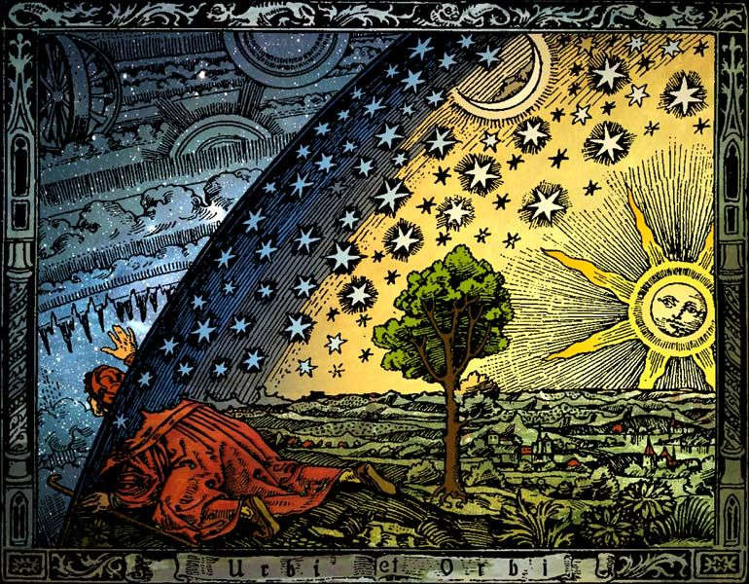
Classical cosmogony

Slide 12
Emergence of modern cosmology

Slide 13
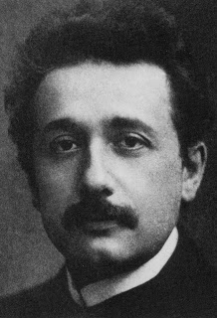
Birth of scientific cosmology
At the end of 1915, Einstein published his equations of general relativity, a theory which is a geometric representation of gravitation.
As in general relativity space-time is constrained by inside masses and energy, the universe (space-time) is no longer an independent container.
It can then be apprehended by the objects constituting it:
Scientific cosmology was born!
One should dare to do it. I did it!

Slide 14
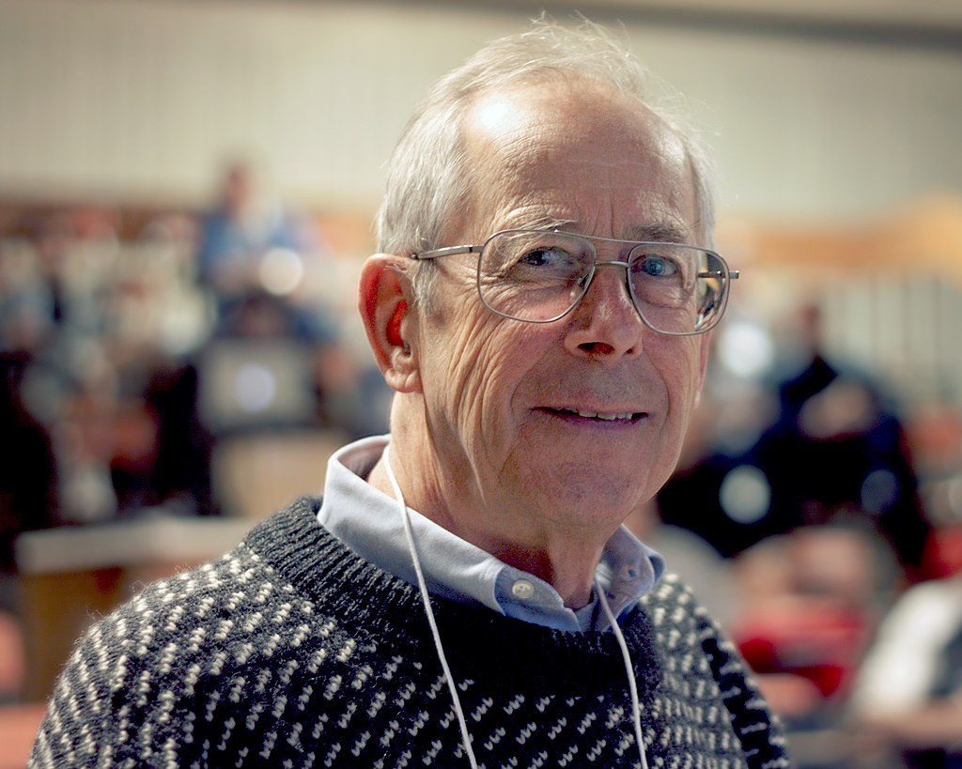
Did you say Big Bang ?
James Peebles, Nobel price 2019, for his contribution to modern cosmology
The standard model of cosmology
Big Bang

Slide 15
Surprising words ….….
“The first thing to know about my discipline is that its name, the Big Bang Theory, is not right, as it suggests an event and a place, but both are false”, told James Peebles, one of the three 2019 Nobel Prize winners in physics, to an intrigued audience.
(Quoted by Huffington Post)

Slide 16
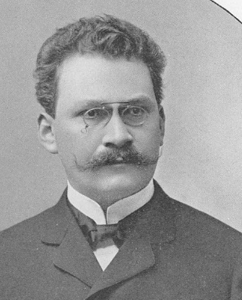
Are these words really surprising ?
James Peebles does not dispute the results of the Standard Model, to which he contributed, but its anthropomorphic representation. The universe is supposed to have a birth (the Big Bang is a creation) somewhere, at some place, and then a life and a death.
Indeed, the concepts used are time and space, with which, of course, we are familiar, but which have no physical character in relativity.
Zeit und Raum Kaputt!
As stated by Minkowski in 1907, only the space-time in relativity has a physical character, time and space being reduced to be only shadows of the spacetime!
Minkowski

Slide 17
Does the universe have a history or is it the history?

Slide 18
Has the universe a history or is it the history?
Einstein's equation defines the universe as a space-time. In Newtonian language this means that it describes the universe in all its spatial and temporal expansion. In other words, it contains all the information about the universe. So far as gravity is concerned, it is the full history.
General relativity being a geometric theory of gravity, this is described by a manifold, a geometric object that needs nothing other than itself to fully define the related phenomenology.
The problem that arises then, is only that of its existence!
The chronological narrative, (the universe has a history), results from a particular time/space foliation. But, per the covariant structure of the general relativity any other method will give the same physical results.

Slide 19
The current cosmological model. A chronological story
The phenomenology of an expanding space results from this particular description of the cosmological model and is only the point of view of observers, traveling on divergent geodesics oriented by their proper time, seeing the other geodesic observers moving away.
If it simplifies the calculations, we'll use it, it should be taken for what it is: One model among endless others.
But it blurs an essential property of the covariant relativistic description: Einstein's equation defines the existence of a spacetime, which is something without beginning or end, which has neither past nor future, and which is not in expansion.
Past, future and expansion are internal properties linked to the structure of this space-time. We must not confuse our past and our future with that of the universe!

Slide 20
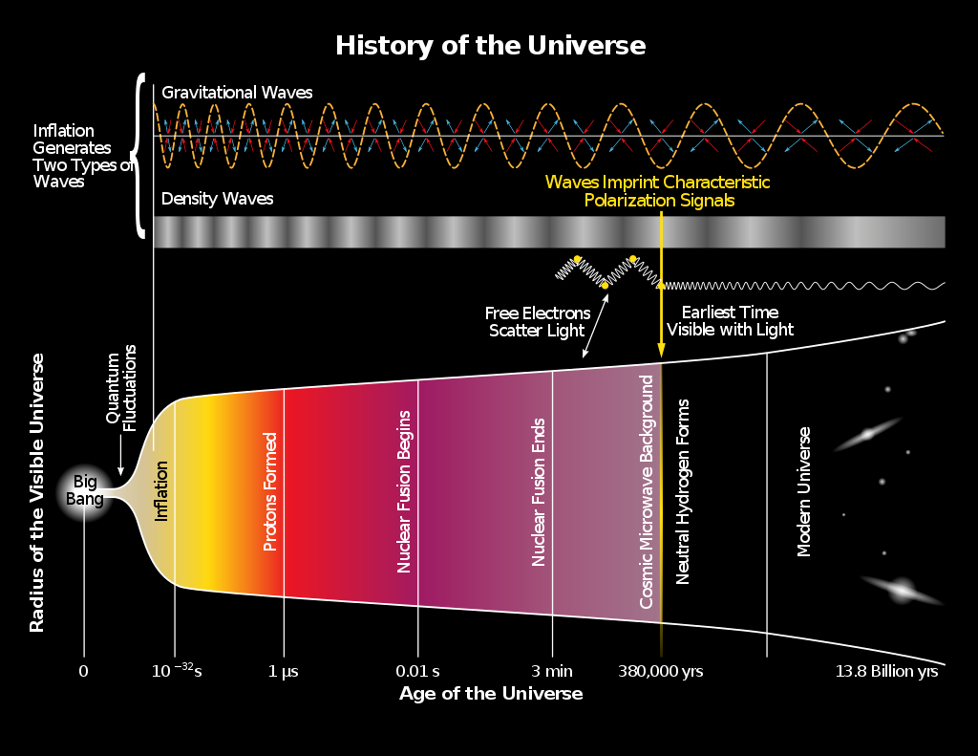
Standard model of cosmology

Slide 21
Dimensional scale
The Standard Model assigns 13.7 billion years (in cosmological time) to our universe.
If we go back in human history to 13,700 years, in the history of the universe we are newborns (last millionth).
Based on these data, the ratio between the age of the universe and the average human lifespan (80 years) would be around 170 million.
But this comparison is inadequate, because cosmological time is not our current time. Evaluated in our own current physical time, the Big Bang is rejected at infinity of our past, this meaning that it is impossible to observe it. The ratio of the two times is given by what is called "temporal dilation", associated with the spectral redshift, tending to infinity when approaching the Big Bang!

Slide 22
Gigantism vs complexity
For the space, the ratio between the size of the universe (40 x 10⁹ al today, expansion included, in this foliation model) and that of a man (1.7 m) is approximately : 2,2.10²⁶ in linear, therefore approximately 10⁷⁹ in volume, a gigantic number which, per an unexpected coincidence, is that of the number of particles of the universe, estimated to 10⁷⁹ !!!!
To the physical vastness (approximately 10⁷⁹ protons) of the universe, the human brain, which is part of it, responds with gigantic combinatorial complexity, immensely greater.

Slide 23
The primordial universe
From fields to particles

Slide 24
The cosmological standard model
(Big-Bang).
The universe at Planck's time 10⁻⁴³s until t = 10⁻⁴⁰s
It is speculated that the universe was incredibly hot and very homogeneous. The immense universe that we observe today was confined in a very small volume, where only fields could exist (with their own characteristics) that the appalling temperature masked.
This universe is expanding very rapidly, (in the standard model).

Slide 25
The cosmological standard model
The great unification breaks down around 10⁻⁴⁰s
The temperature is so high that all interactions are indistinguishable.
Around 10⁻⁴⁰s a symmetry breaking will occur allowing the interactions to be differentiated either all simultaneously (super-symmetric theory: speculative) or in two steps:
first of all, the gravitation and later simultaneously the 3 others by a another symmetry breaking (per the standard model of the QFT).
It is also assumed that the Higgs field, conferring mass to some particles, would emerge from this breaking around this time

Slide 26
The cosmological standard model (Big-Bang).
Inflation: around 10⁻³⁴s
Very early in the history of the universe, between 10⁻³⁴ s and 10⁻³² s, it is assumed that an inflation phase (exponential expansion) very short (≈10⁻³² s) but of duration equal to 100 times the age of the universe, (linear exponential expansion: e¹⁰⁰) has occurred.
It will play an important role in particular by dilating quantum fluctuations. Thanks to a part of dark matter in matter, thermodynamic smoothing will not be totally efficient. The small remaining inhomogeneities will be the seeds of large structures.
This inflation will also solve the problem of the horizon and the lack of curvature of space.

Slide 27
Creation of matter
As it expands, like a gas, the temperature of the universe decreases. Around one GeV (10¹³ ° K) particles and antiparticles begin to emerge.
As long as the energy corresponding to the temperature of the universe is not very inferior to that of their mass energy (1 GeV for nucleons), particles and antiparticles are at equilibrium (creation rate and annihilation rate are similar).
Then, when the temperature is too low, they will annihilate each other by generating photons

Slide 28
t =10⁻⁴ s, annihilation matter-antimatter.
Despite the symmetry of the equations, the imperfection at work results in a slight excess of matter. This is still a mystery, even though there are some clues for explaining it.
Massive matter-antimatter annihilation results in a billion photons per surviving nucleon, all contributing to thermal equilibrium!
The protons and neutrons surviving the annihilation with the antiprotons and antineutrons will be stable around t = 0.0001s (the temperature of the universe is then around 100 MeV).

Slide 29
t =10⁻⁴ s, protons and neutrons equilibrium
But the equilibrium between protons and neutrons which resulted from symmetrical reactions at high temperature (p ↔ n) will break because the neutron is handicapped by its mass slightly greater than that of the proton and, at t = 0.01s, there are only 9 neutrons for 10 protons.

Slide 30
Primordial nucleosynthesis, genesis of the
nuclei of the first atoms

Slide 31
t =1 s, primordial nucleosynthesis
The temperature is about 1 MeV, i.e ten billion degrees Kelvin (≈ 700 times the temperature at the center of the Sun). This is the order of magnitude of the binding energy of the nucleons in the nucleus.
There is only one neutron left for three protons!
The only way to save them would be to combinate the neutrons and protons for getting a stable nucleus.

Slide 32
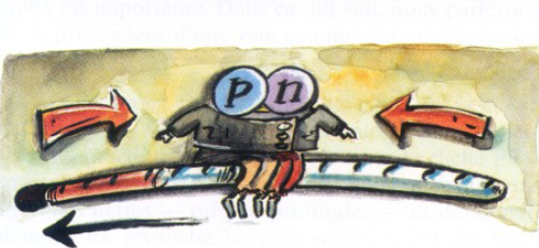
t =1 s, primordial nucleosynthesis
This goes through deuterium, the temperature is low enough to allow it, but deuterium has a fragile nucleus.
The fast expansion of space does not favor this reaction but, above all, the photons at thermal equilibrium, whose energy follow a statistical law, which are in overwhelming excess (1 billion per nucleon) destroy all nuclei of deuterium.

Slide 33
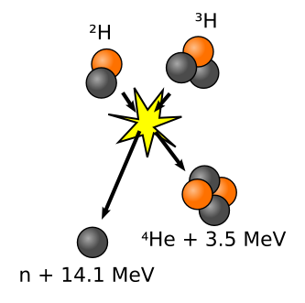
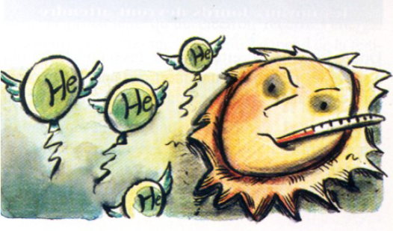
t =100 s, Nucleosynthesis becomes effective
The temperature has dropped under one billion degrees Kelvin (about 70 times the temperature of the center of the Sun: The deuterium becomes stable.
This allows to the nuclear fusion of the whole universe to become efficient and in less that 100 seconds, the surviving neutrons (1 neutron for 7 protons at that time) are incorporated into the deuterium nuclei, which in turn fuse into helium-4 nuclei which are very stable..

Slide 34
In less than 100 s, nucleosynthesis saved the neutrons while preserving 90% hydrogen, fuel for the following steps, just what had to be done ...
Just on time, because already decimated by the p ↔ n reactions which penalized it, the free neutron is unstable and decays into a proton with a period of about 15 minutes. Because of this late fusion the temperature is too low for generating significant amounts of other elements and fusion will stop around t = 200s.
.

Slide 35
Imperfection as a creative principle
Without the indetermination of quantum mechanics, the universe too symmetrical, too perfect would have been sterile.
Without the matter-antimatter asymmetry, matter would not have survived, without the critical value of this asymmetry (10⁻⁹), the nucleosynthesis would have been either far too efficient or totally ineffective and the story would probably have ended there.
This principle, which indicates that a system cannot be in a perfectly determined state appears as a founding and necessary principle of physics. It will allow, later on, the emergence of astrophysical structures from inhomogeneities and with these critical parameters the universe will evolve long enough to allow our existence...

Slide 36
The first atoms, the universe becomes transparent to electromagnetic radiation

Slide 37
t= 380 000 years, The universe becomes transparent for light
The electron-proton plasma in space continues to expand and to cool and when it reaches a temperature around 3000 K, the electrons will be able to be associated with nuclei for generating stable "neutral" atoms:
Therefore, the universe becomes transparent to light.
.

Slide 38
t= 380 000 years, The universe becomes transparent for light
It is this "last" radiative (CMB) "surface" that satellites like Planck analyze because it is the oldest radiation observable in the history of the universe.
Note that it is by analyzing the patterns of temperature fluctuations (imprints left by previous events and that dark matter has partly preserved) that we induce, within the framework of the theoretical model, this earlier story.
.

Slide 39
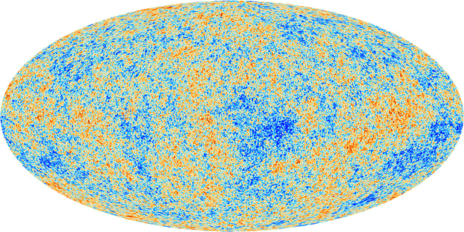
.
Image of the CMB (Cosmic Microwave Background) measured by the satellite Planck (temperature in false colours). The information, the imprints of the history, is included in the image. This is a good example of the Plato’s cavern : One sees shadows of a supposed physical reality!

Slide 40
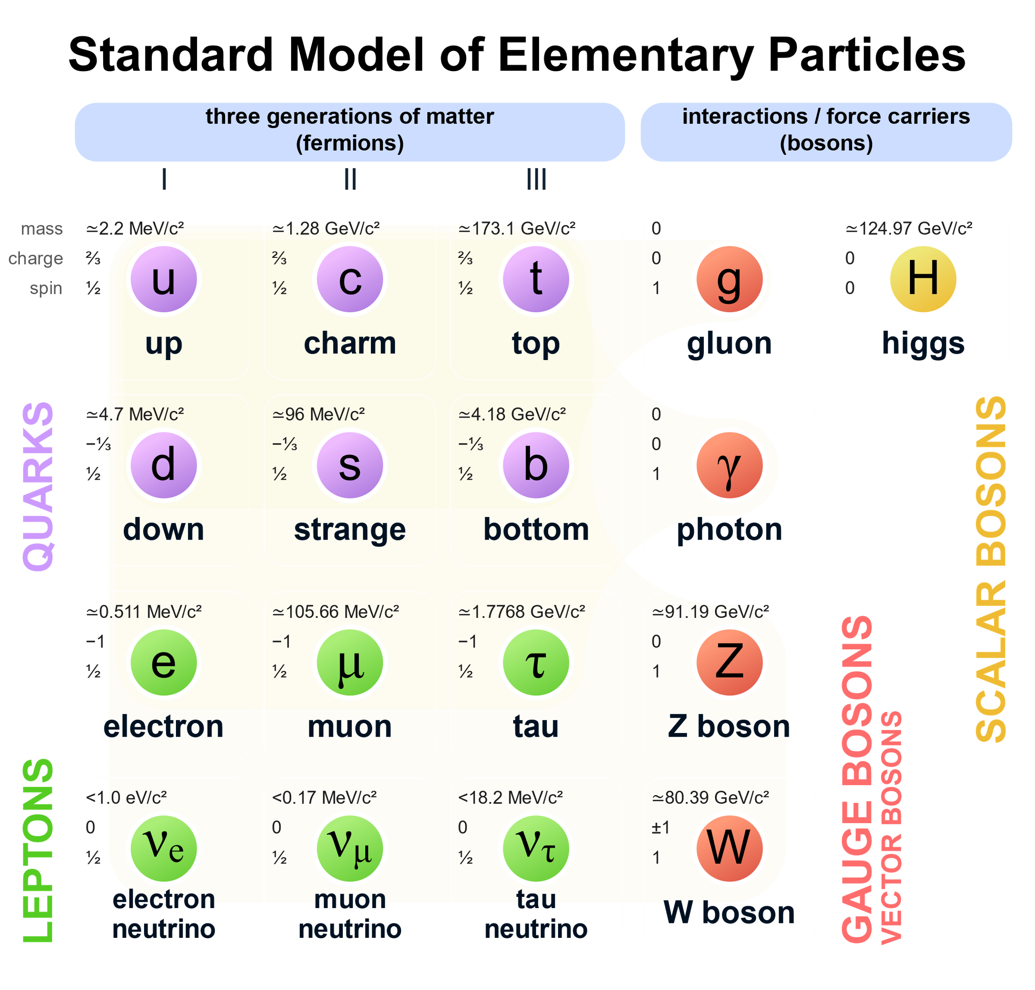
Standard model of Elementary Particles
This table represents what matter is made of (the fermions) at elementary level and all the possible interactions (carried by the bosons) between them.
This seems really too simple for explaining the incredible complexity of the universe!
We did not listed antimatter, as it seems almost absent in the universe

Slide 41
The four known interactions
Gravitation: Given its extreme weakness will govern the universe only on a large scale - Very large masses (galaxies, stars, planets and their satellites, comets, etc.): Govern large structures. Long range interaction.
Electromagnetism: Interaction 10⁴⁰ times stronger than gravitation, Ensures the cohesion of atoms, molecules, ... Long range interaction.
Strong interaction: Works between quarks and ensures, among other things, the cohesion of protons and neutrons. Range 10⁻¹⁵ m.
Weak interaction: Allows quarks to change flavor: transform a neutron into a proton and vice versa. This changes the chemical element which depends on the number of protons. Breaks parity symmetry. Range 10⁻¹⁷ m.

Slide 42
Critical importance of neutrons
Considering to “chemical” elements, which are the building blocks of all macroscopic matter, one lists 92 stable elements.
This diversity is made possible by the neutrons which ensure the cohesion of the nucleus.
The protons which are positively charged repel each other and the nuclear force binding the nucleons would be quickly overwhelmed by the electric repelling, without the neutrons which, as they have no electric charge, allow to reinforce the binding of the nucleus.

Slide 43
Critical importance of neutrons
Without neutrons the number of stable elements would be very small and a chemistry allowing life as we know it, that we will henceforth call life, based mainly on elements such as carbon, oxygen, nitrogen and hydrogen among others, would not be possible

Slide 44
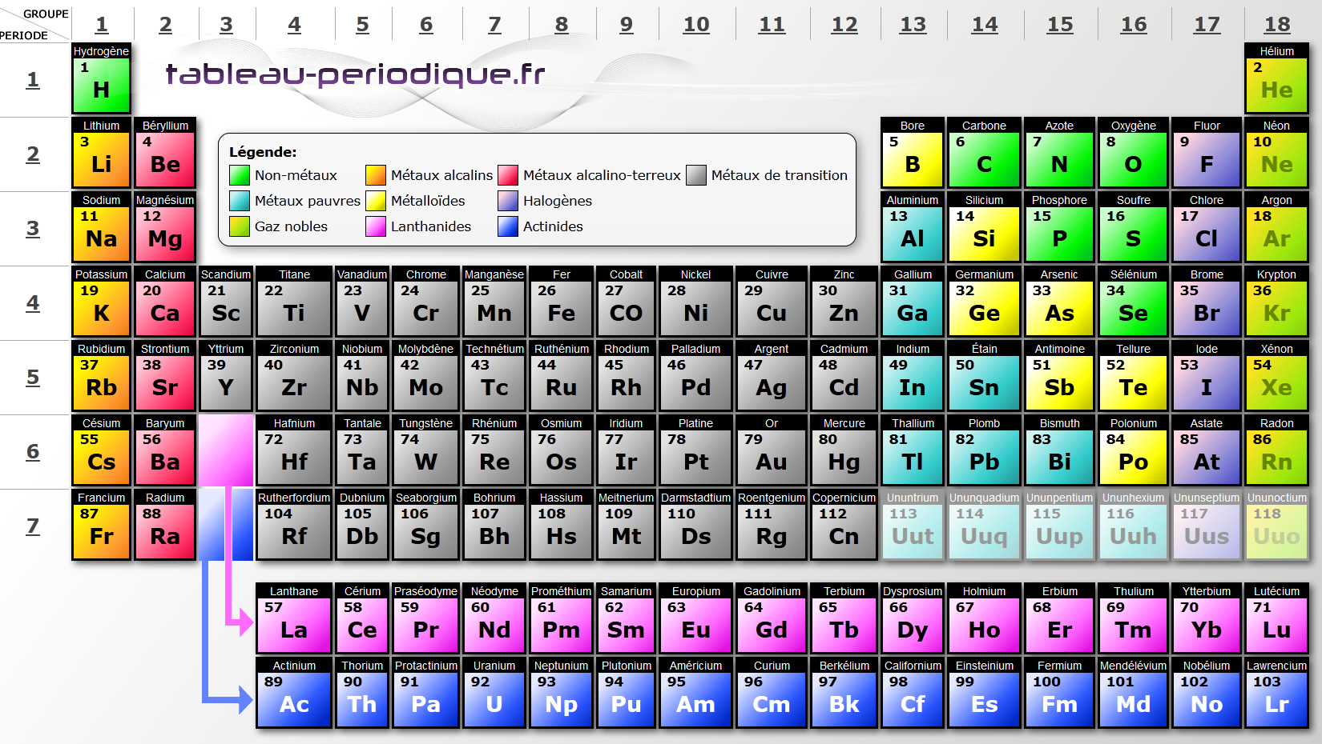
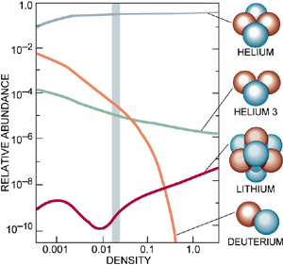
.
The primordial nucleosynthesis (whole universe in fusion) generated practically only helium, (the composition of the universe then being about 90% hydrogen of 10% helium) and traces of deuterium and lithium. Poor result given the cosmic phenomenon at work.
But it is fortunate because, if it had been total, the story ended there! Indeed, it preserved the essential "fuel" of fusion (hydrogen) for the rest of the events and saved the neutrons which will allow the complex and varied chemistry that we know.

Slide 45
The miraculous synthesis of carbon
This carbon, which is synthesized, among others, in supernovas, is a fundamental element in the chemistry of living things.
The abundance that we see is considerably greater than what theory predicted. It benefited from the fact that, in a carbon nucleus, it exists a state with an energy which is surprisingly "resonant" with the energies of the elements to be fused, otherwise it would have been very inefficient.
This has only recently been validated mathematically by supercomputers.

Slide 46
These same parameters, in the dynamics of the universe, will also allow the emergence of life

Slide 47
Creative chance ?
The creative imperfection at work (we have indicated that perfection is sterile) seems to imply that, in the universe, anything is possible.
In fact, what could happen is constrained by the four fundamental interactions, that we have mentioned, which play the role of the "DNA" of the universe. Anything is not possible: only can exist and happen what is compatible with these interactions!
Note that the energy context plays an essential role for allowing these interactions to impose their own constraints with more or less strength, because as previously told, a hellish temperature masks all of them .

Slide 48
Creative chance ?
Thus, the diversity of living chemistry requires a context in a low-energy window to manifest all its complexity.
The rules induced by the 4 fundamental interactions may seem too simple to describe all this complexity.
But, from these few laws there follows a considerable combination of possibilities, in particular through electromagnetic interaction, as shown by the extreme diversity of association of atoms into molecules allowed by the layered structure of the cloud of electrons.

Slide 49
Gravitation at work
Dark matter at work
As we have indicated, the interaction of radiation with baryonic matter has the effect of leveling inhomogeneities.
But since dark matter does not couple with radiation, this allowed to preserve a large part of these inhomogeneities making the constitution of large structures possible. This is what happened with the plasma, constituting the universe until decoupling. It is this result that the Planck satellite shows.

Slide 50
Galaxies and stars formation
These lumps of matter (consisting mainly of gas) will collapse by a complex mechanism and then, at a local level, this gas will give rise to stars with their planets.

Slide 51
The stars finish the job
Then, the stars which are the factories of atoms will produce other atoms.
In particular, the supernovae which, in an explosive fusion, synthesize many elements, such as carbon, oxygen, nitrogen etc ... will spread them in space.
This will allow another generation of stars, incorporating these elements, to generate planetary systems.
The Sun with its planets, their satellites and a myriad of other bodies, is one of these second-generation stars.

Slide 52
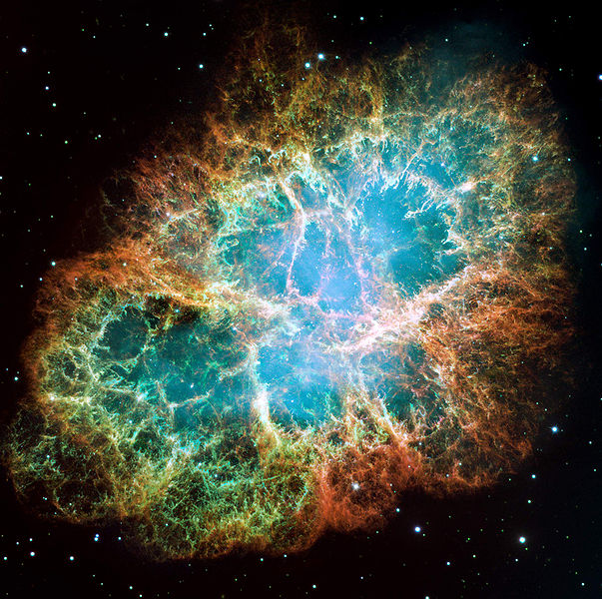
Explosion of a supernova
Supernova SN1054, which exploded about 1,000 years ago, whose debris currently spans hundreds of billions of km, seeds interstellar space with heavy elements synthesized during the star's life and during its explosion. . These heavy elements are the constituents of terrestrial planets like the Earth and are necessary for life.

Slide 53
Explosion of Nova in 1572 (Tycho)
This type of phenomenon (a new star visible to the naked eye) has always aroused reactions of fear among populations. For scientists they have been a godsend.
The absence of parallax and the fixed position with respect to the fixed stars put an end to the dogma of the incorruptibility of stars, which nevertheless caused some major inconvenience to some followers of this new interpretation, which was considered heretica

Slide 54
Formation et evolution of le solar system

Slide 55
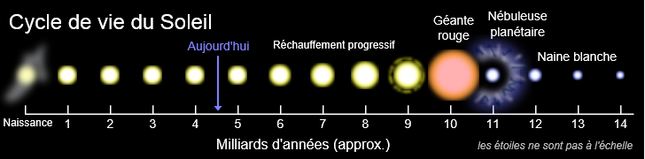
Birth and life of the Sun
Four and a half billion years ago a star exploded in the vicinity (in the cosmological sense: d <100 al) of the region where the Sun (our star) would form.
It seeded this region with various chemical elements (which we will find in the sun and the planets) and the shock wave of the explosion will cause a collapse (over hundreds of millions of years) of the gas, leading to the formation of the solar system.

Slide 56
The Sun
The result of this collapse is a star of a mass such that ignition of nuclear reactions may occur for stopping the collapse (the heart is only at 15 million degrees Kelvin, far from the billion degrees of primordial nucleosynthesis). The tunnel effect plays an important role (Gamow peak).
Each kilogram of Sun produces less than 1 mW, a thousand times less than our body!
This sluggish fusion is a godsend, because burning poorly, it burns for a long time and satisfies one of the requirements for the emergence of intelligent life, a process which requires a long time for emerging.

Slide 57
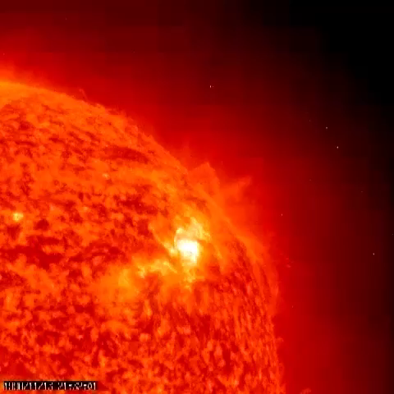
The Sun in action

Slide 58
Primordial solar system
The hydrogen cloud collapses as it swirls around. In order to collapse it must get rid of its angular momentum. It does this by transferring it to the proto-planets. It can then heat up to ignite the nuclear reactions.
It is a cataclysmic scenario where the largest bodies still burning, undergo incessant bombardments of meteorites of all sizes tearing the crust, causing the appearance of volcanoes.

Slide 59
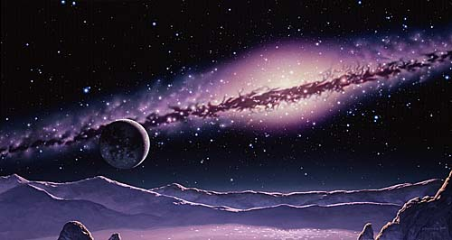
Primordial solar system

Slide 60
Formation and evolution of Earth

Slide 61
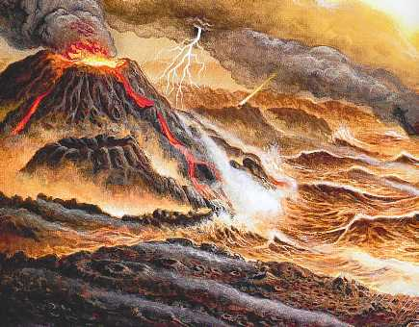
Primordial solar system
It's hell. It will only calm down after a few hundred million years. But the high temperature of the center of the Earth (several thousand degrees) is the relic of this formation whose cooling is slowed down by natural radioactivity (10¹³W), compared to 3.10¹⁷W received from Sun. But under these conditions needless to say that no life can develop.

Slide 62
The atmosphere
A planet the size of Earth can sustainably retain an atmosphere of not too light gases. If it will quickly lose its hydrogen (abundant) and probably also the rarer helium, the Earth can permanently retain the molecules of gases such as nitrogen N2 (of volcanic origin), which Mars, smaller, cannot can not do.
There is no free oxygen (gas O2) at this time, the first forms of life will be anaerobic.

Slide 63
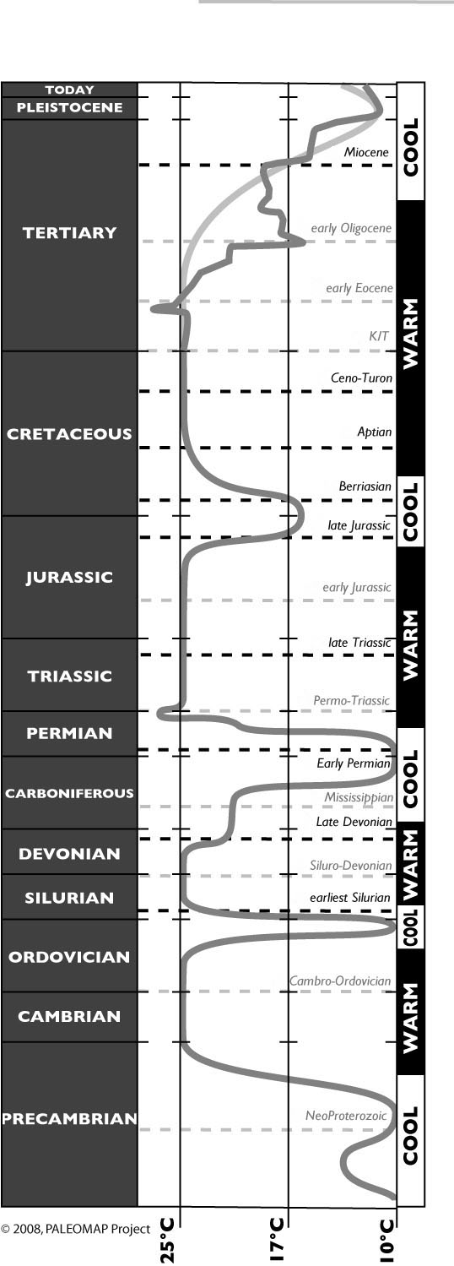
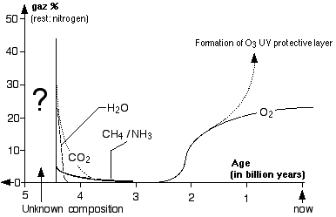
Atmosphere et temperature
The greenhouse effect of the atmosphere raises the temperature of the Earth's surface by 35 ° C (15 ° C instead of -20 ° C). Note the major event of "great oxygenation" about 2 billion years ago.

Slide 64
The problem of liquid water
When the huge meteoric bombardment ceased, the temperature stabilized. Liquid water is essential for the development of life as we know it. In fact, the water molecule is relatively abundant in the universe (comets made of ice attest to this).
Different hypotheses exist on the formation of the oceans:
Some believe that it is the rain following very violent thunderstorms that is the cause, others prefer to attribute it to the passage close to the tail of a comet. This last hypothesis which was prefered is now called into question. It is believed that the Earth was already incorporating a large amount of water into its rocks.

Slide 65
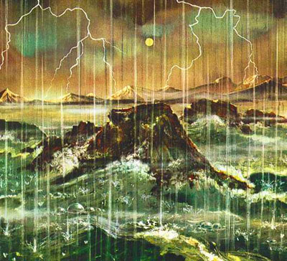

Slide 66
Conditions for the emergence and development of life (as we know it)

Slide 67
Is this enough for emergence of life?
Very restrictive additional conditions are required.
A planet with regions where the temperature is in a narrow window around 15 ° C, adapted to the chemical reactions of life.
In general a nearby stable star which provides an adapted energy, no unstable nearby stars.
Liquid water.
A gaseous atmosphere suitable for chemical reactions with living beings, which protects (O3) from harmful radiation and small meteorites and also from harmful solar wind particles.
A magnetic shield to deflect harmful charged particles with the atmosphere as a second line of defense (Aurora borealis)

Slide 68
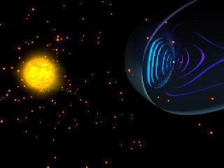

Slide 69
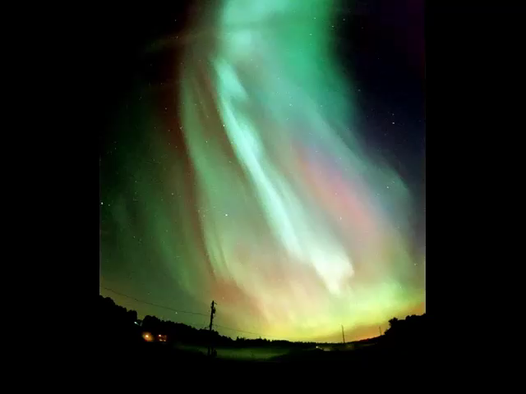

Slide 70
It is also required that all this should be relatively stable, because the process of evolution towards complex beings has taken billions of years on Earth.
Catastrophes (example extinction of the dinosaurs) from time to time seems to be necessary also for exiting "stable states“ which are not necessarily optimum. Maybe something similar could happen to us….
Mutations and a natural "selection-evolution" mechanism.
In other words, a balance between a stable and a unstable world where errors provide mutations and stability allow evolution.

Slide 71
Emergence and evolution of life

Slide 72
Organic molecules in the interstellar medium
Where do organic molecules come from? Observations of the interstellar medium show significant diversity and molecular richness. More than 180 molecules have been detected in the interstellar medium, in stellar and pre-stellar envelopes and in comets.
These molecules are mostly organic (contain the element carbon) and about sixty of them are considered complex (contain at least 6 atoms).
Cf: https://www.techno-science.net/actualite/molecules-organiques-zones-froides-interstellaire-N13933.html

Slide 73
Conditions for life emergence
Gravitation allows the creation of a context ensuring accommodation (the planets) and, in cooperation with other interactions, energy: In stars stability is ensured by the balance between gravitation and thermal pressure of nuclear reactions.
The strong and weak interactions allow the constitution and evolution of a few dozen stable nuclei of atoms which will be the main building blocks of life.
Electromagnetism is involved in the constitution of complex molecules via the outer layers of electrons

Slide 74

The mysterious emergence of life
The possibility does not imply the realization but remember that a theory is something where you will find what you had put in.
As we are not explicitly part of the hypotheses, it may seem surprising that the possibility of our emergence can exist.
But, like in theater where if the author is not physically present on stage he is in the story, a theory being a human construction, our existence is indeed, implicitly, in the hypothesis. .
The resulting theory, by coherence and construction, contains our existence. But doesn't that introduce a logical bias?

Slide 75

Are we slaves of our DNA?
In "Sapiens", Y. Harari speculates that the real winner in the evolution of Sapiens is not us but our DNA (our specie). We would only be a way for its reproduction!
Quite hard for our ego!
Our mortal character would be justified by a better efficiency of DNA reproduction and improvement, with the basic cycle: Birth-growth-reproduction and death when reproduction is no longer active.

Slide 76
The limits of the scientific mind
The existence of singularities in general relativity and the quantum indeterminacy marks the limits of these theories. These theories are neither perfect nor definitive, but it is questionable whether these limits are structural or simply related to flaws in these theories.
If we may hope to push further these limits with new theories, can we really cancel them? In cosmology, this peculiarity is exacerbated since we are part of the universe. We have underlined the implicit imprint of the mind of the physicist whose nature and limits constrain the theory.
Moreover, the universe, in the theory, is an abstract object in his mind, independent of the universe, this in contradiction with the fact that all the physical experiences for testing the theory are made from inside!

Slide 77
The limits of the scientific mind
Just as in relativity where space time and movement have been replaced by space-time which is not a synthesis of it but a new element of which, time, space and movement are only shadows , shouldn't we create a new entity, on the basis of a generalized covariance, which on this model would integrate space, time, movement and the mind of the physicist as shadows?
The information of a physical system, including humans interacting with it, would be the fundamental variable. A measurement is a transfer of information from one part of the system to another part. The example of quantum mechanics shows that the possibility of a measurement changes the nature of an experiment.

Slide 78
The limits of the scientific mind
In the Young's slit experiment, the possibility of detecting the passage of a photon through a slit changes the phenomenology (no interference fringes), even if the detector does not detect anything (contrafactuality). But we have acquired information (the photon has passed through the other slit) unlike the case without a detector!
In the EPR experiment, 2 entangled photons A and B will have opposite polarizations (50% probability for each). But we don't know which one. The measurement of A fixes the polarization of B. It is assumed that the state of A, is transmitted instantaneously to B. But is the phenomenology changed, if we suppose that the state of A was determined, but unknown as its knowledge reveals that of B!

Slide 79
Antropic principle
This principle, which should rather be called an anthropic argument, comes in two versions:
Weak anthropic principle: It states that since we are here to talk about the universe, it should come as no surprise that the universe has all the features and parameters required for allowing our existence.
Strong anthropic principle: It stipulates a finality. Regardless of any religious response that has its own narratives, the universe was bound to produce beings like us. This can be seen as a response to a frustration of feeling like an unwanted child, but it remains an open topic of a philosophical nature.

Slide 80
The future starts now…

Slide 81

Preservation of life

Slide 82
Which destiny for mankind ?
We have shown how, and through what implausible scenario, the universe was able to give birth to humanity.
Are we an exceptional or even unique case or, simply, do we believe it, because of our isolation linked to the considerable distances which separate the stars and the galaxies?
Either way, our fate is, at least partially, in our hands.
To realize the value of what the universe has given us, there is nothing like taking a step back.

Slide 83
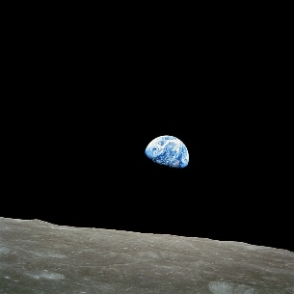
Earth, our spaceship in hostile space

Slide 84
The manned space missions have shown us that space is a very inhospitable environment because it does not contain the essential elements of our life and we have to take them with you.
It is also hostile, because we are exposed to meteorites and harmful radiation of incredible violence.
The Earth with all the resources and protections it offers us (which have allowed the development of life) speeding at 1 million km / h in the universe is our spaceship, let's keep it in good condition.

Slide 85
Epilogue
We have described the tortuous journey that has led to us. If the chronological account has enabled us to describe the related phenomenology, it is in an anthropomorphic view.
The covariant approach, where the modeling of the universe uses a space-time, which needs nothing other than itself to exist, shows us that the only problem to be posed is that of its existence, in fact rather of ours, if we follow the existentialists, who like JP Sartre, consider our existence to be prior to everything.
If our thinking habits are not familiar with this approach, general relativity, for example, offers a model.

Slide 86
Epilogue
In addition, the singularities, unavoidable in general relativity, Hawking has demonstrated theorems on this subject, mark the asymptotic limits of physics. Quantum indeterminacy, contra factuality, and the EPR paradox defy understanding.
We, ourselves, assuming we were alone, abandoned in an unchanging place, between the time we realize our existence and the time we lose it, would we have developed the concept of something existing before our life and after our life. ? We would be aware of our existence in the present, of a past and future during our existence, but would we extrapolate beyond?

Slide 87
Epilogue
A way out may be found in a change in our way of thinking, because if we take it as "reasonable" it is nevertheless only a kind of habit shaped by our experience.
When we consider the renouncements that had to be inflicted on our mind to describe the relativity that destroyed our concepts of time and space that we thought that they were universal and linked to the very nature of our mind and the even worse renunciations in quantum mechanics where it is, in addition, determinism that had to be abandoned, we see that we are not immune to a new upheaval of this type.

Slide 88

More on the big bang
https://www.lestroiscolonnes.com/auteur/jacques-fric/vous-avez-dit-big-bang/
https://vous-avez-dit-bigbang.fr/

Slide 89

Location of visits of the site : vous-avez-dit-bigbang.fr

Slide 90
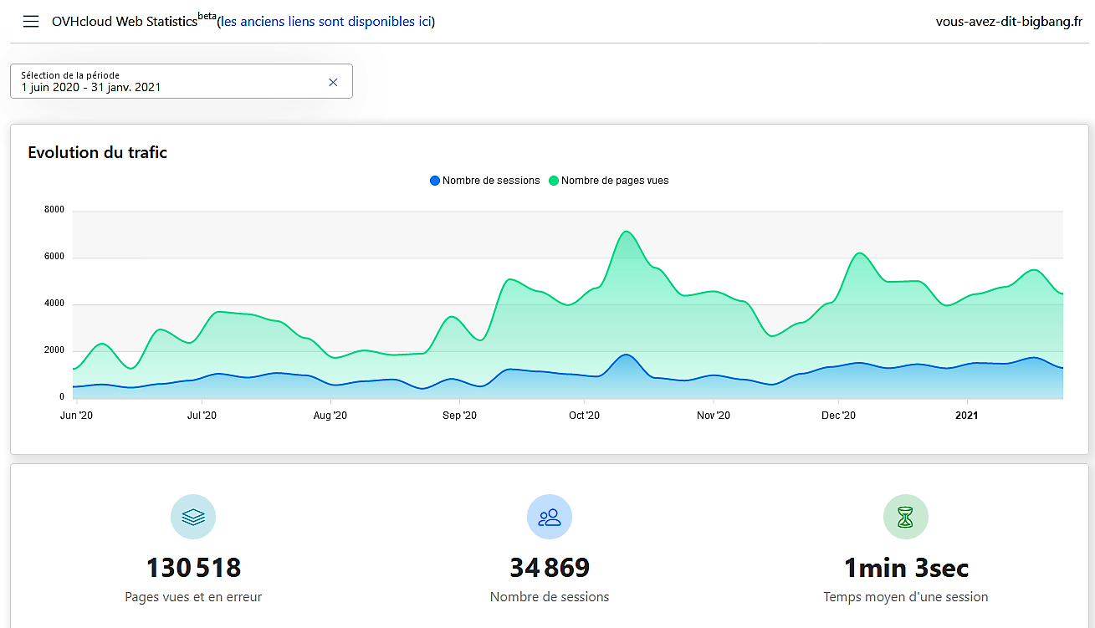
Some historic of visits of the site

